Slide 1
Introduction to Data science Project 2
Mehrad Haghshenas
Research question:
To what extent does the presence of local police stations contribute to deterring crime in New York City?

Slide 2
Datasets
NYPD crime dataset:
A breakdown of every felony, misdemeanor, and violation crime denoted by the New York Police Department between 1 January 2022 and 30 September 2022.
This dataset has 396979 observations and 36 predictors: 1- age 2- sex 3- time 4- coordinates 5- crime types …
Police stations in NYC dataset:
This dataset has 77 observations (precincts) and 3 predictors: 1- name 2- latitude 3- longitude

Slide 3

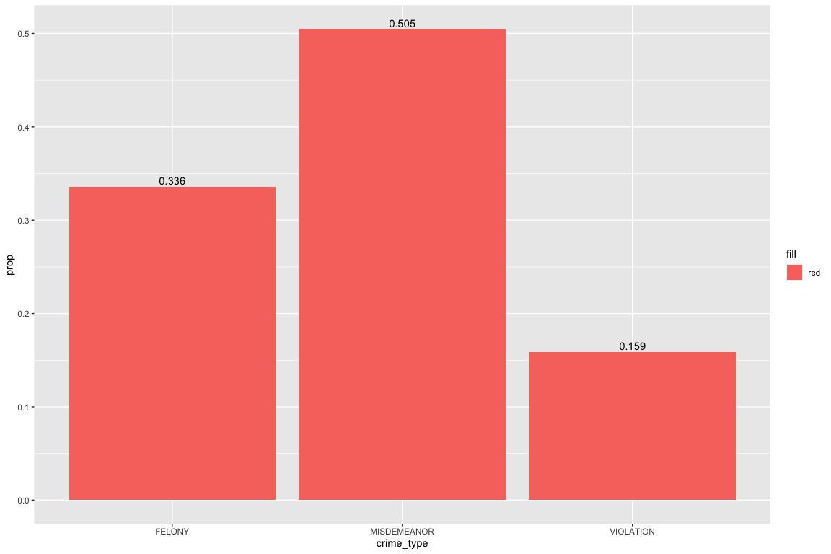
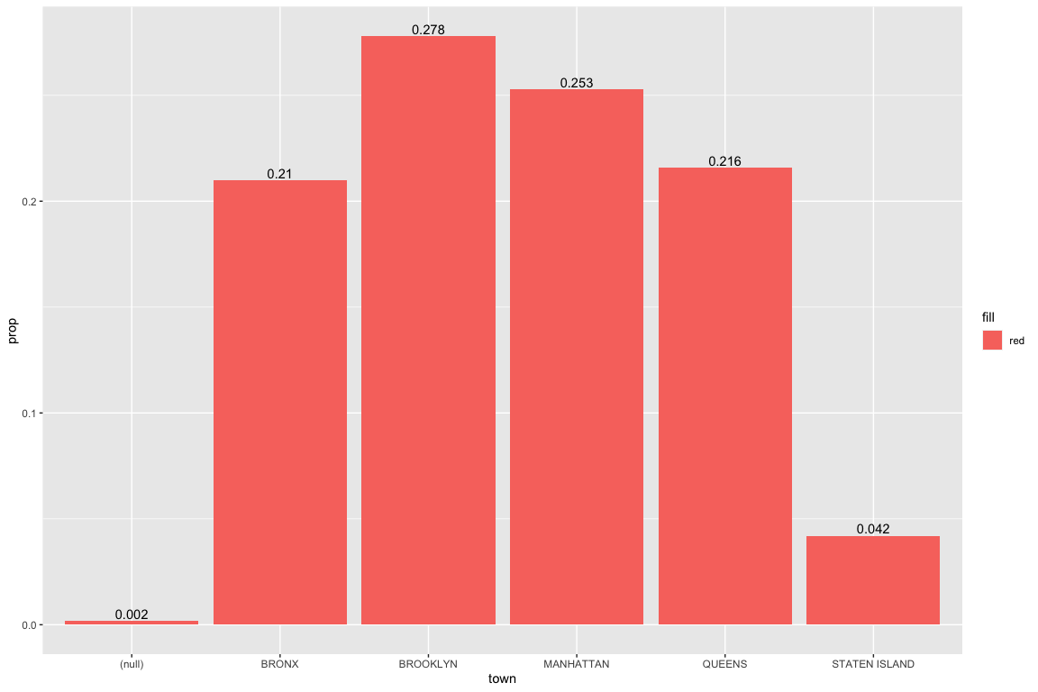
Proportion of crime per type and town

Slide 4
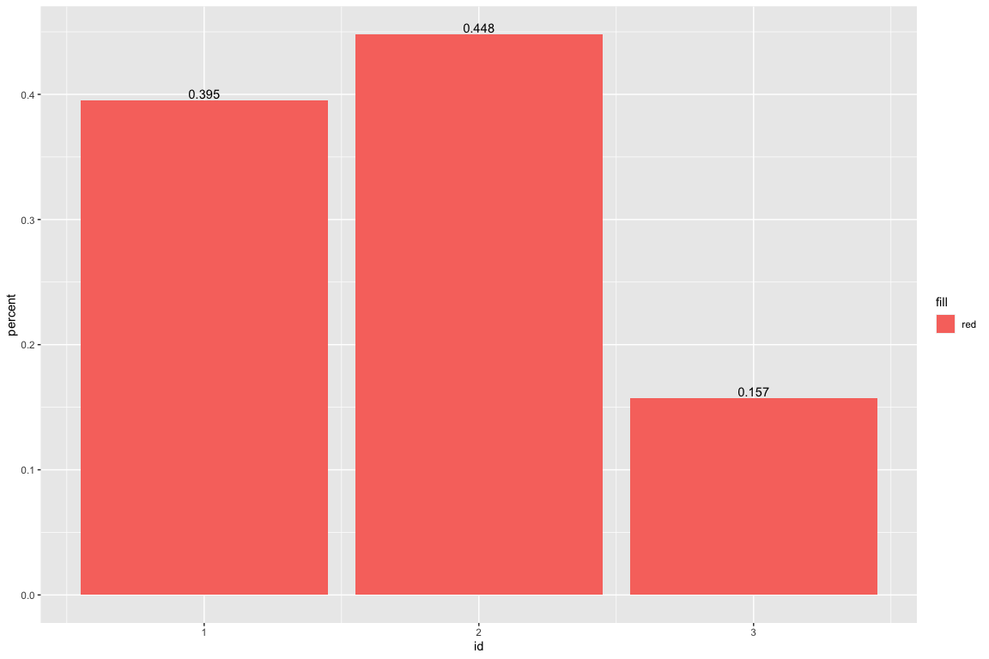

Proportion of crime per Season

Slide 5
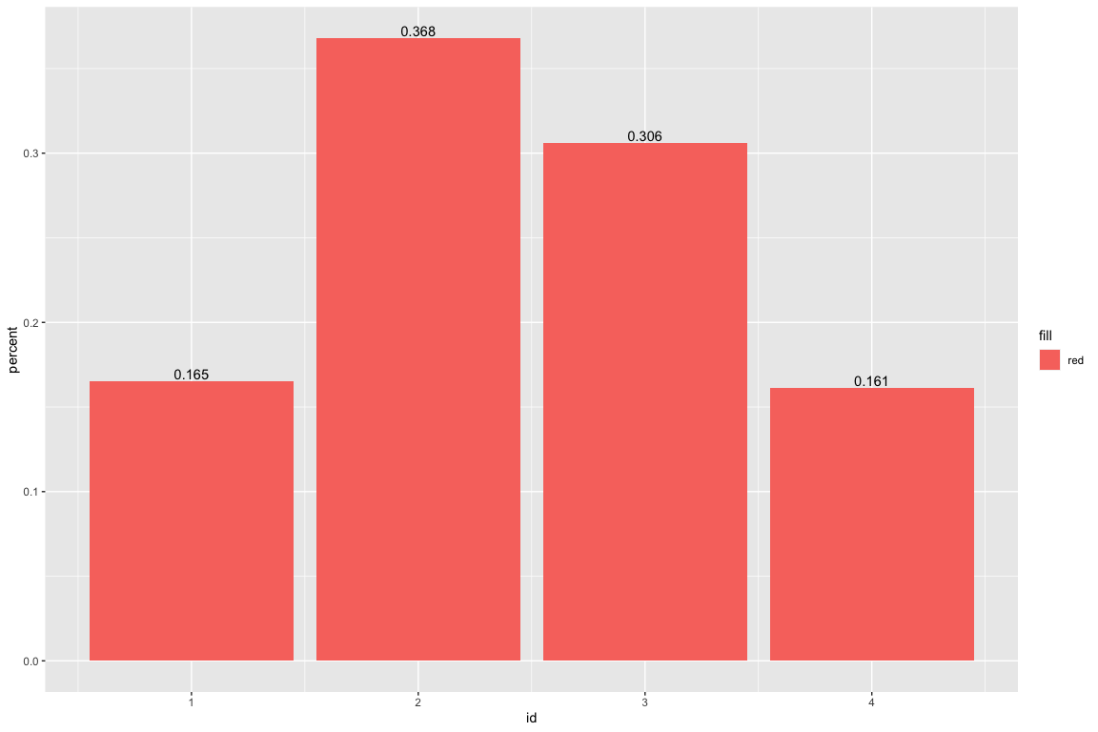
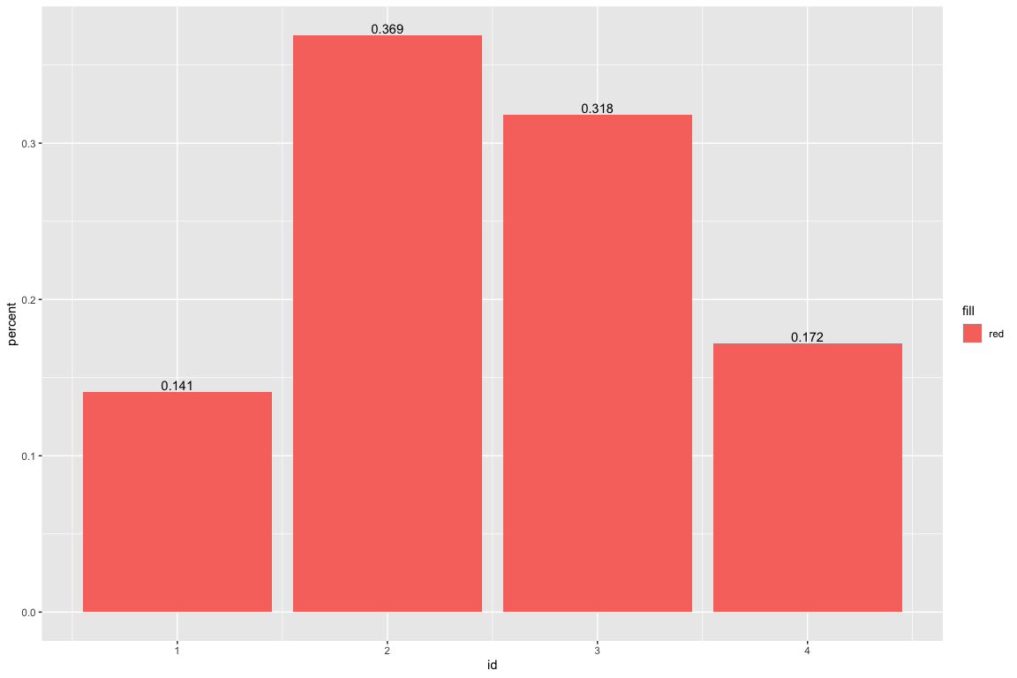
Proportion of crime per time of day

Slide 6
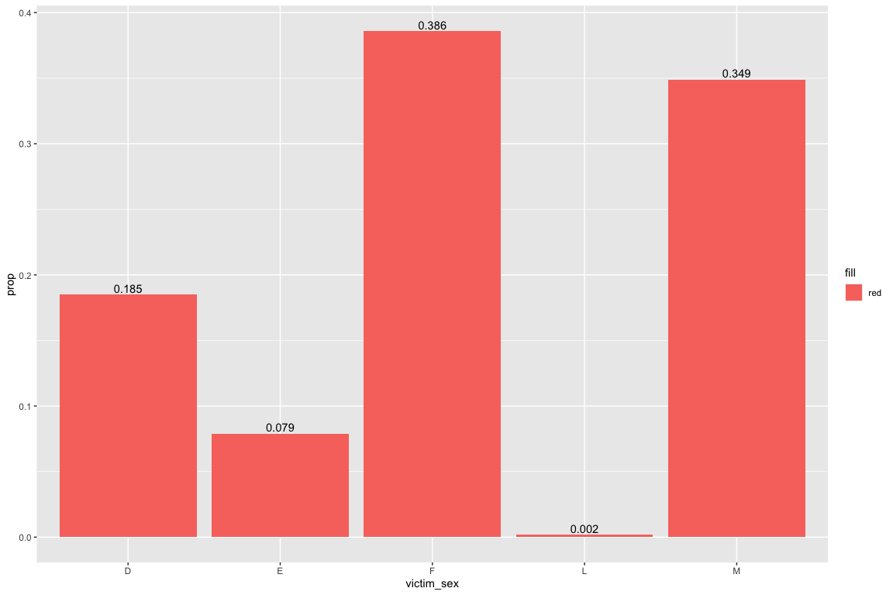
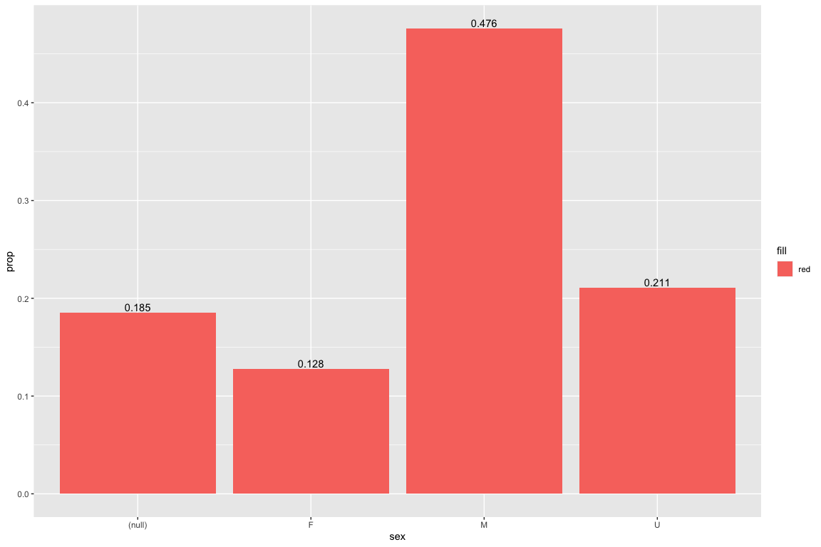
Proportion of crime per sex for suspect and victim

Slide 7
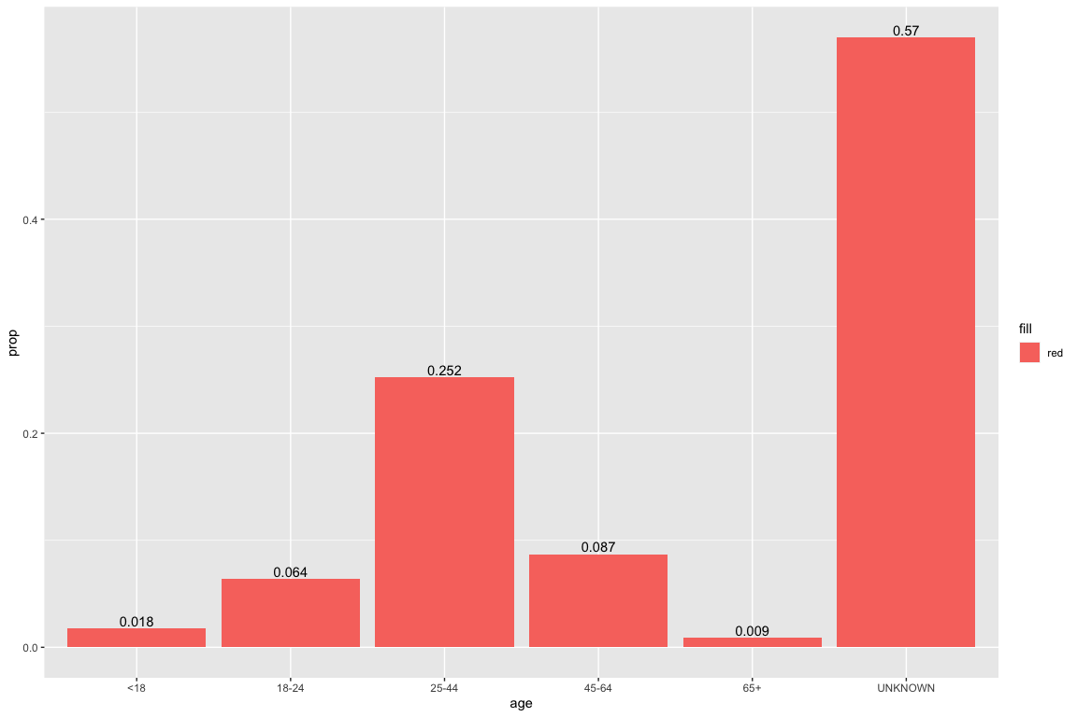
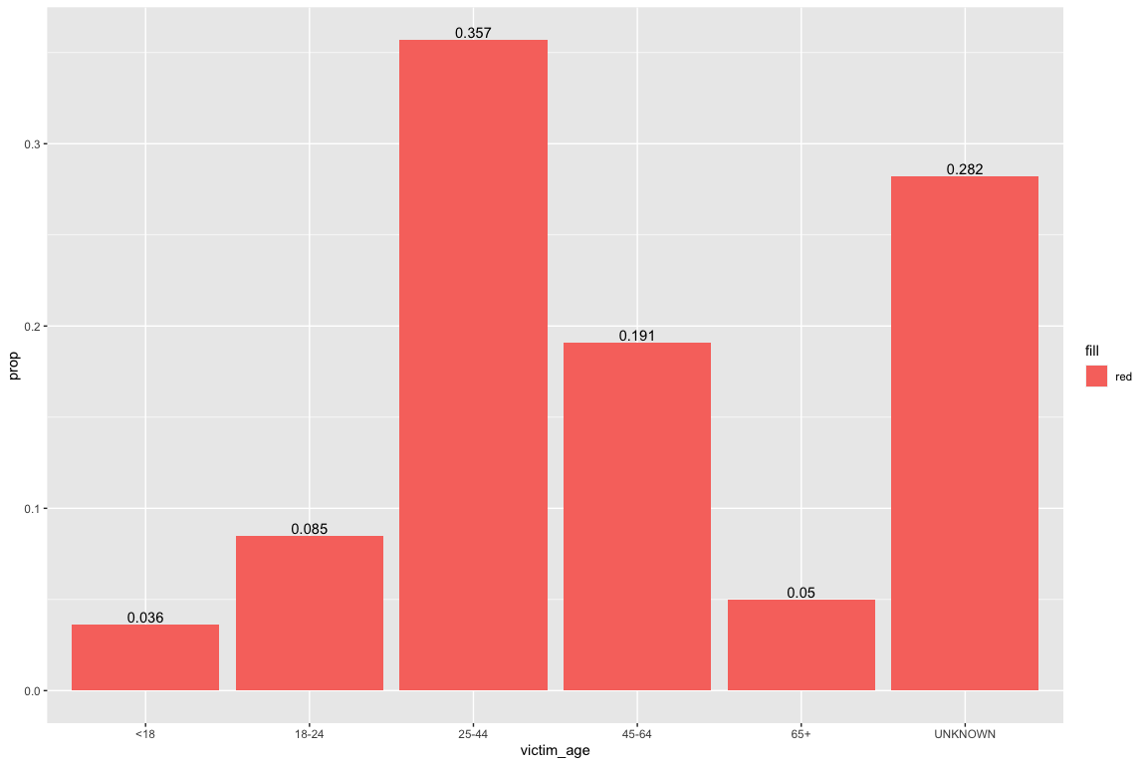
Proportion of crime per age for suspect and victim

Slide 8
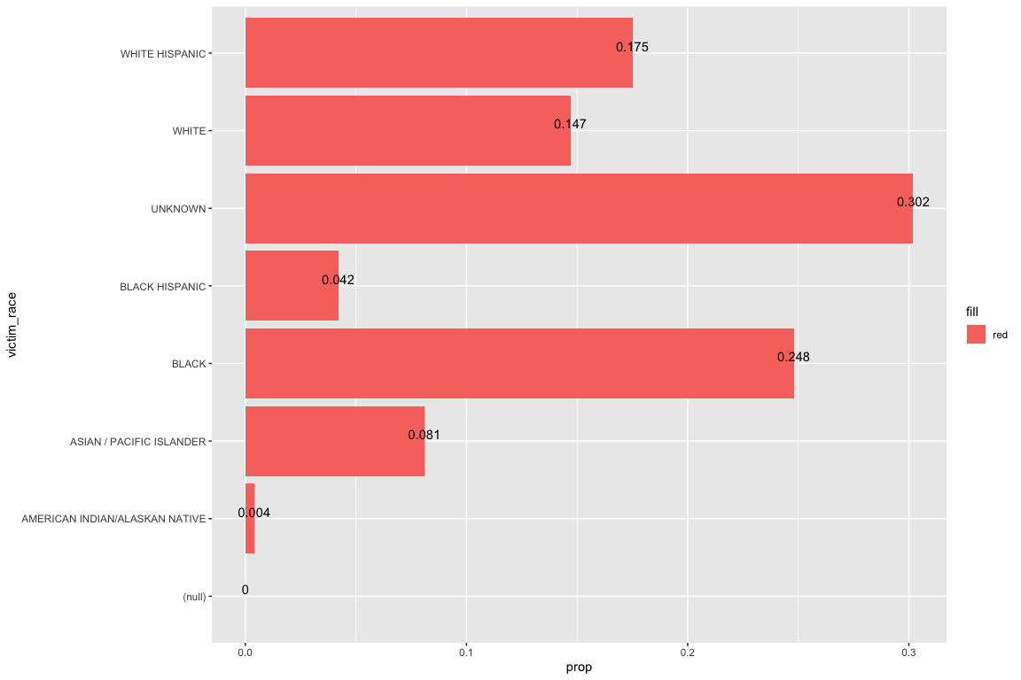
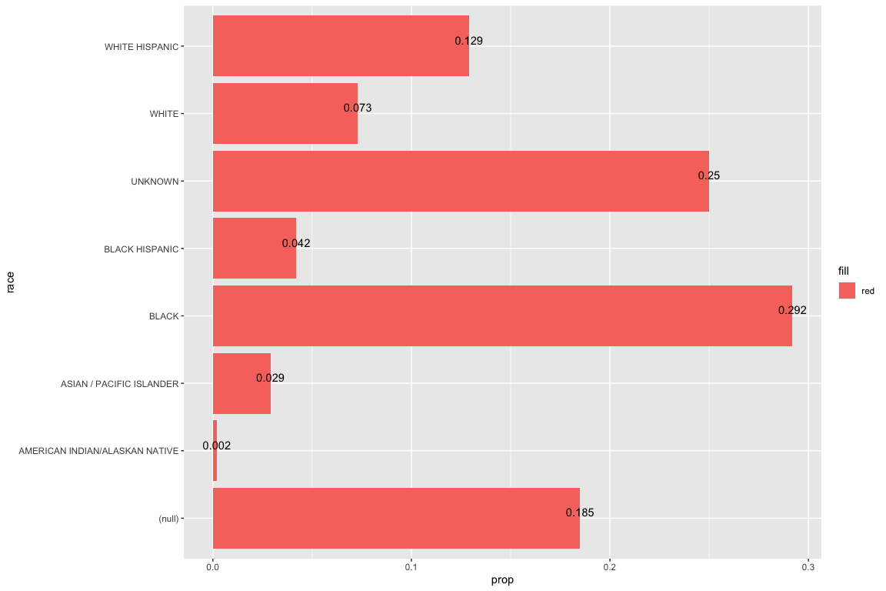
Proportion of crime per race group for suspect and victim

Slide 9
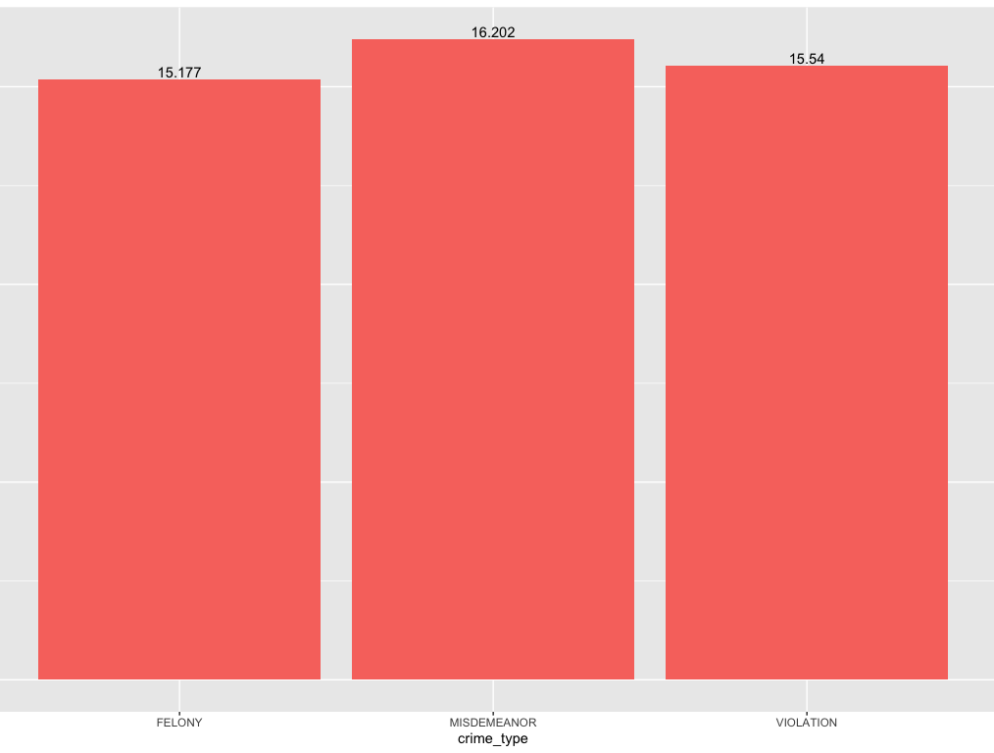
Number of days a precinct is involved with a crime per crime type
There is a significant correlation between the number of days and crime type with a significance level of 0.05.
Kruskal-Wallis test:
p-value = (2.2e-16)

Slide 10
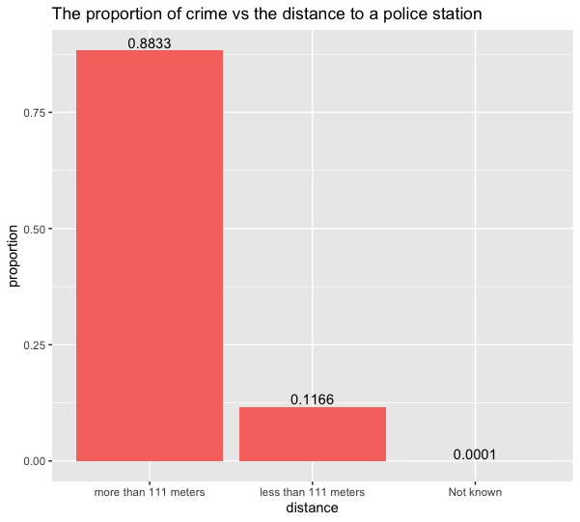
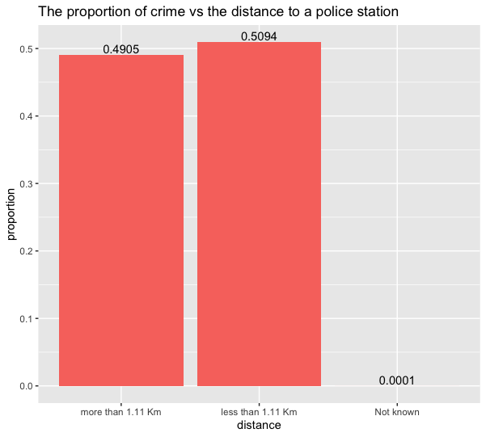
Proportion of crime vs distance to patrol

Slide 11
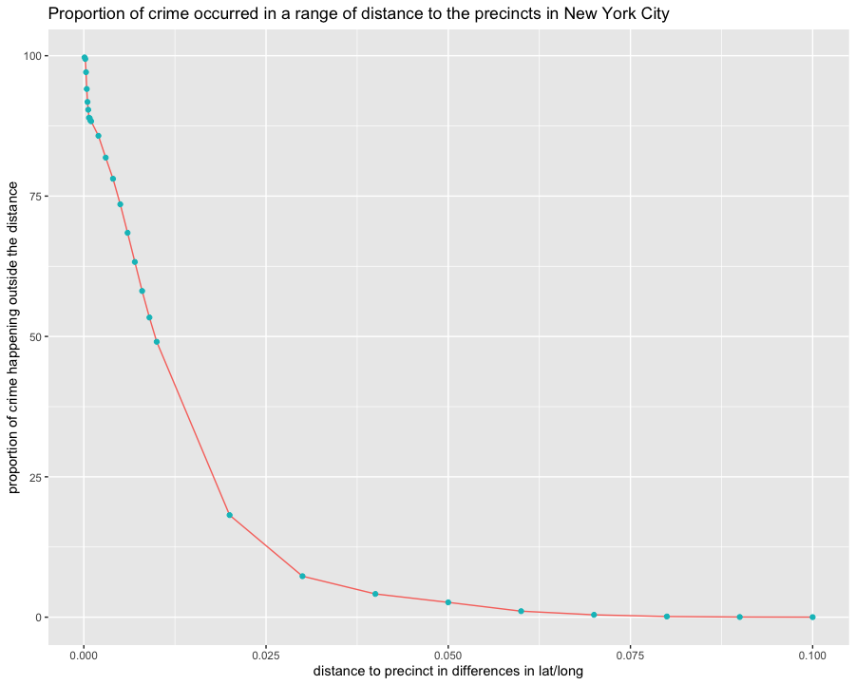
Crime vs distance to patrol

Slide 12
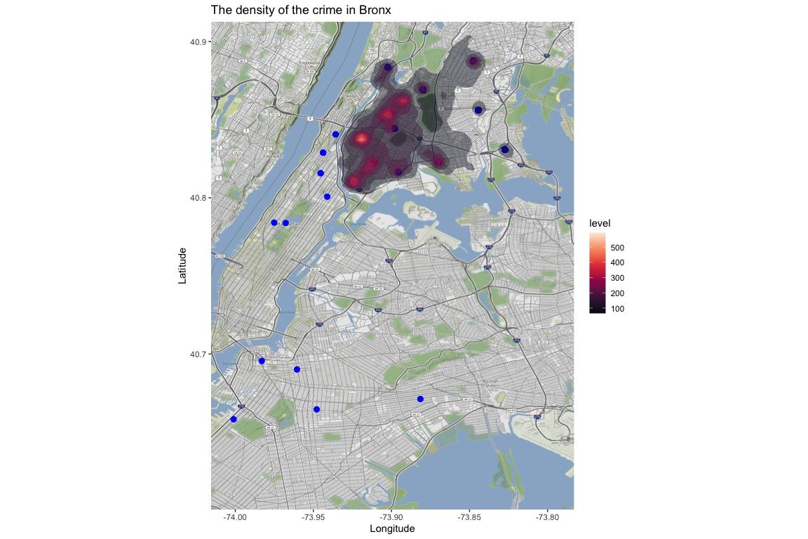
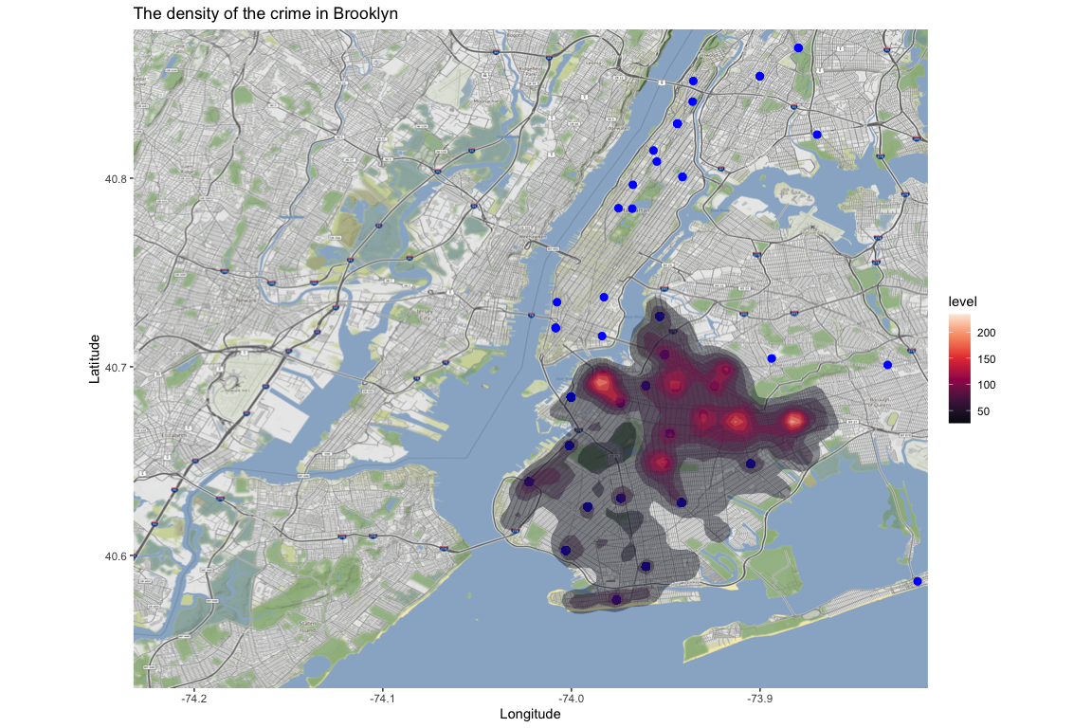
Density of crime vs town of occurrence (Bronx and Brooklyn)

Slide 13
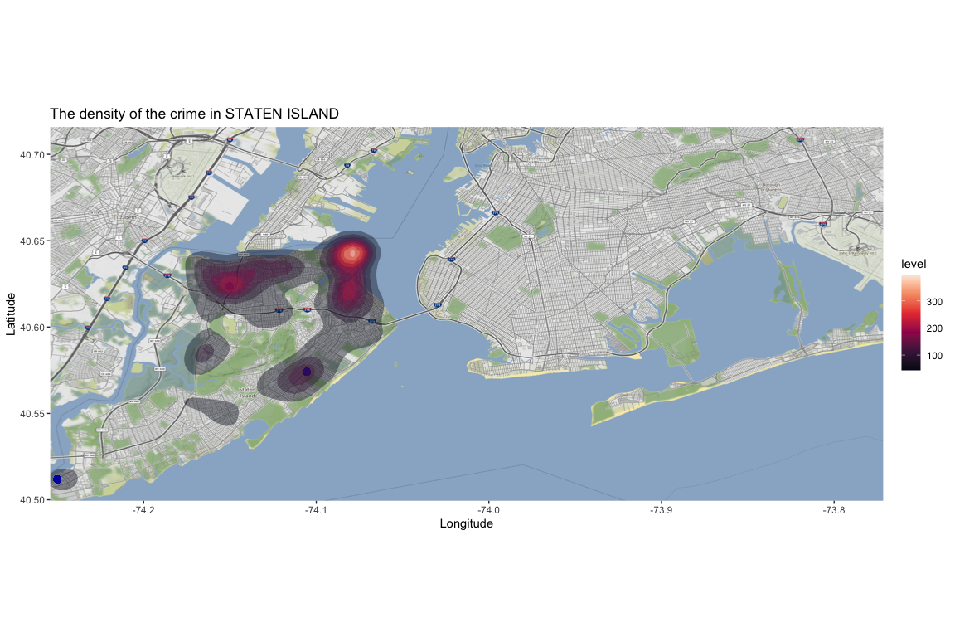
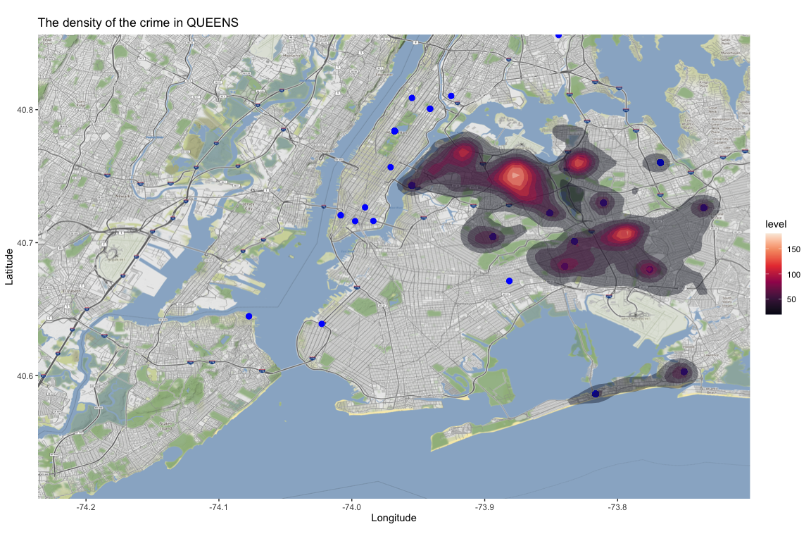
Density of crime vs town of occurrence (Staten Island & Queens)

Slide 14
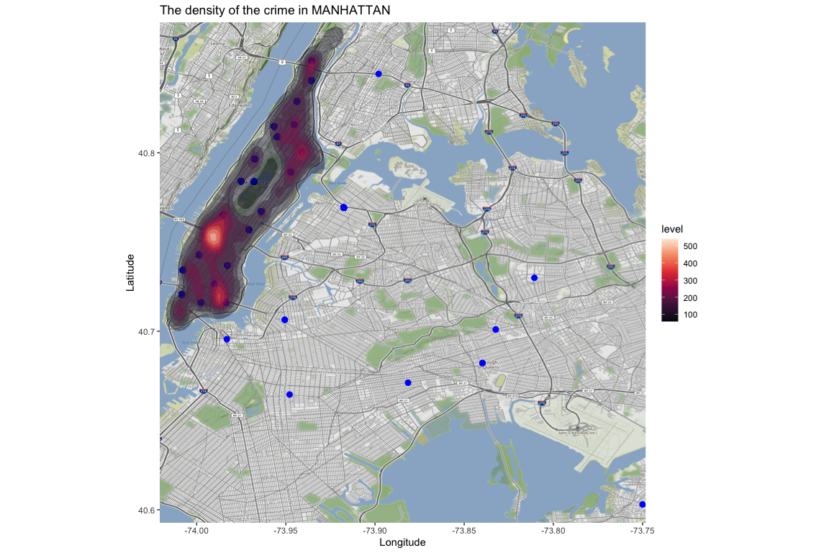
Density of crime vs town of occurrence (Manhattan)

Slide 15
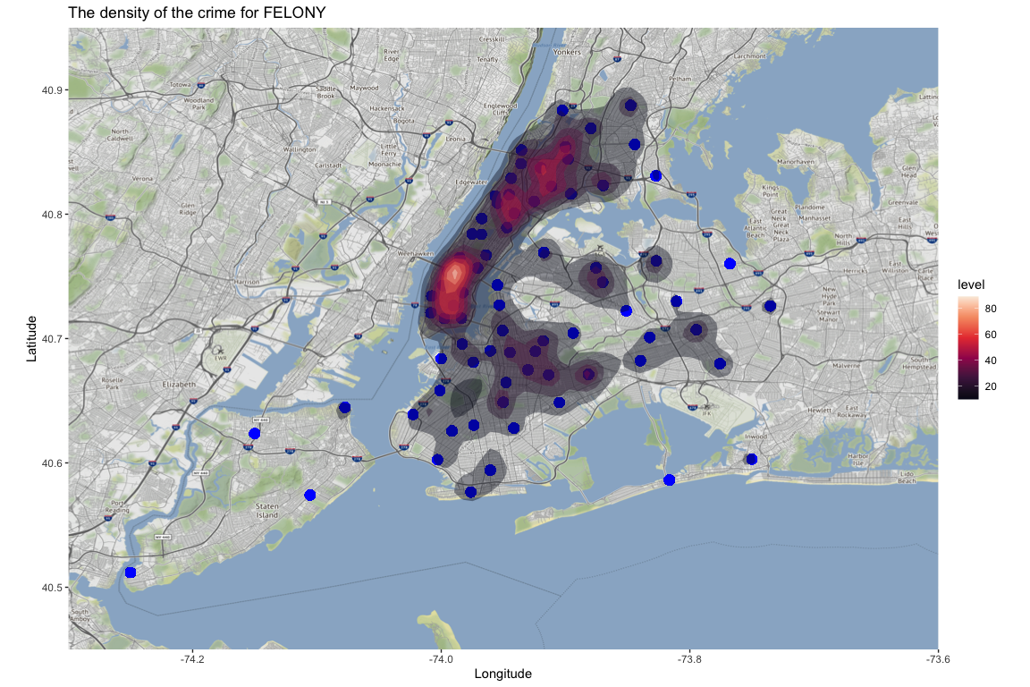
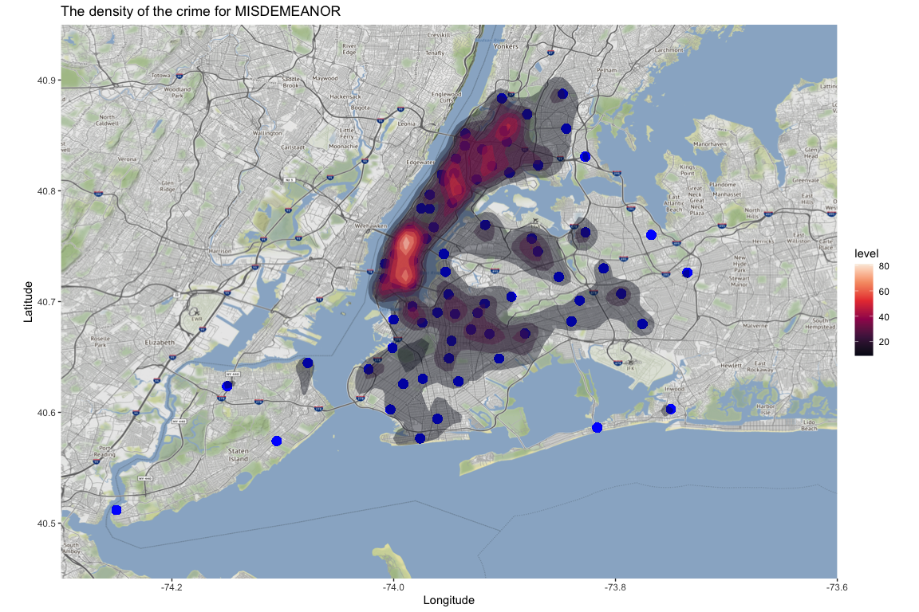
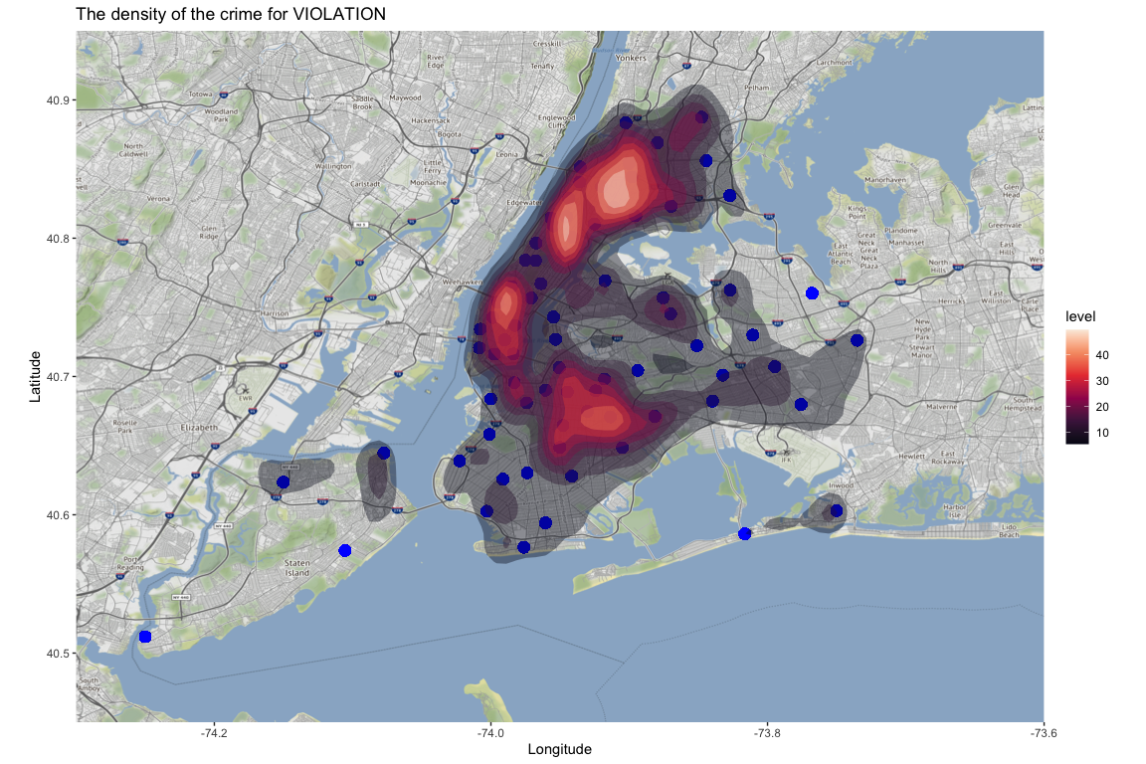
Density of crime vs crime Type

Slide 16

Density of crime in NEW york

Slide 17
Conclusion
the geospatial visualization indicated in large scale, proximity to a precinct and the number of crimes do not have a clear correlation. However, detailed analysis shows that there is a correlation in a sense that the nearer to a police station the less crime happens.

Slide 18
References
Blesse, S., & Diegmann, A. (2022). The place-based effects of police stations on crime: Evidence from station closures. Journal of Public Economics, 207, 104605. https://doi.org/10.1016/j.jpubeco.2022.104605
Alesina, A., Favero, C., & Giavazzi, F. (2019). Austerity: When It Works and When It Doesn’t (Illustrated). Princeton University Press.
NYPD Complaint Data Current (Year To Date). (n.d.). NYC Open Data. https://data.cityofnewyork.us/Public-Safety/NYPD-Complaint-Data-Current-Year-To-Date-/5uac-w243/data
Precincts - NYPD. (n.d.). https://www.nyc.gov/site/nypd/bureaus/patrol/precincts-landing.page

